Slide 1

Diabetes prediction app
Data science internship at exposys data labs

Slide 2
HIMANSHU BOBADE
Bharati Vidyapeeth College Of Engineering, Navi Mumbai
Date of Joining:
May 18th,2021
Mentor:
Y. VishnuVardhan
Date of completion of internship:
June 20th ,2021

Slide 3
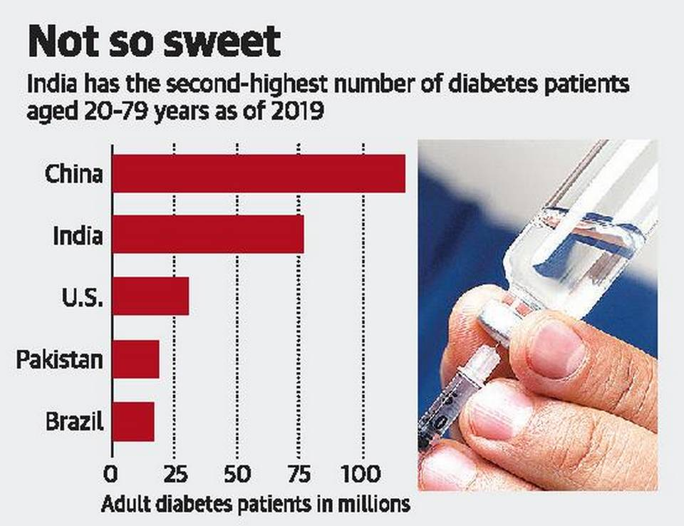
Need for Diabetes prediction app
Analysis shows that there an increase in number of disease reports for Diabetes and will keep increasing.
It is better to find a solution to prevent this disease

Slide 4
Tech Requirements
DATA
Deployment
processing

Slide 5
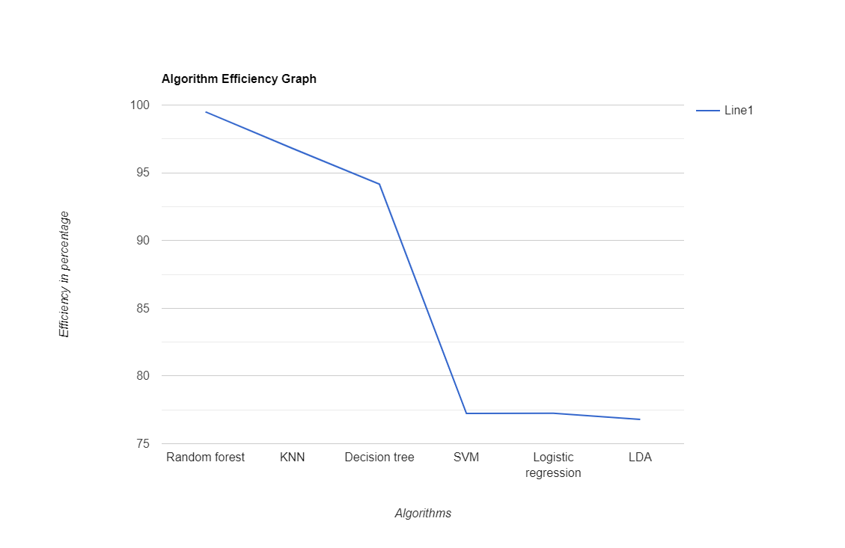
Algorithm Comparison

Slide 6

Data Preprocessing
Outlier fixes
Mean for irregularities
Appropriate data format

Slide 7
Model Training
Create and train Dataset
Test the model
Convert it into pickle for deployment

Slide 8
Deployment using flask
Fetch the input data from user
Process and fit it in model
Display the results

Slide 9

Thank You
himanshuboboade007@gmail.com

